Slide 1
No More Sub Notes!
Presented by Lenessa Keehn
6-12 Business/Computer Teacher
Internship Coordinator
Lead-Deadwood School District, South Dakota

Slide 2
http://fur.ly/4nrk
For all resources listed in presentation as well as the presentation itself

Slide 3
Preparation, Preparation, and more Preparation
Conference/Professional Development
Two-three days of great stuff for you and your classroom!
Two-three days of organizing, collecting, photo-copying
Additional day of just writing it all down
Extra lessons or activities just to limit excess down time for classroom
You are set!

Slide 4
Preparation, Preparation, and more Preparation
Sick child/family emergency
Preparation of the “quick lesson.”
An hour or two at the school to photocopy, organize
Hopefully your backup is enough to cover until you can return

Slide 5
Upon Return…
“The teacher went too fast.”
“He/She didn’t tell us what to do.”
“We couldn’t get any help.”
“No, we didn’t get the handouts.”
“Well, it didn’t work so we just played games.”
“She/He didn’t know how to use the computer. The projector broke.”
Enter your favorite excuse here. ☺

Slide 6
Translation…
Start over.
Begin as if you weren’t gone.
Now you’re

Slide 7
Technology Integration
www.voki.com

Slide 8
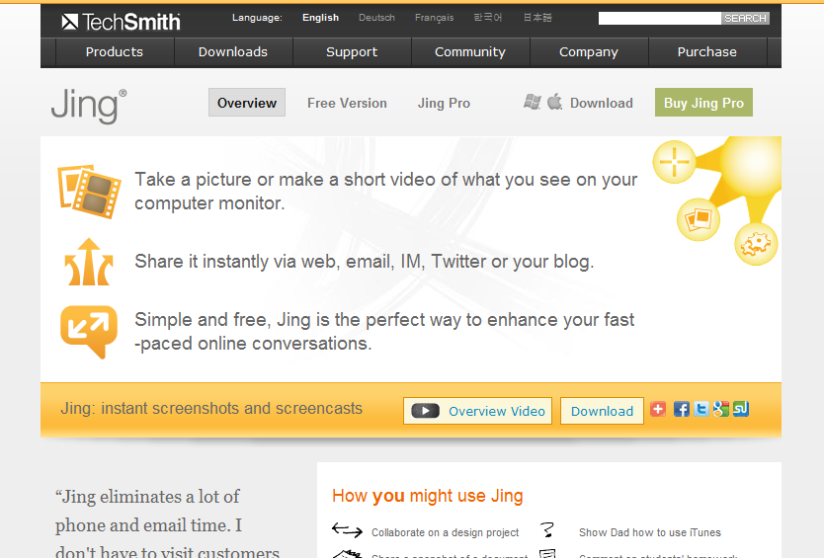
Technology Integration
www.jingproject.com

Slide 9
Technology Integration
www.wikispaces.com

Slide 10
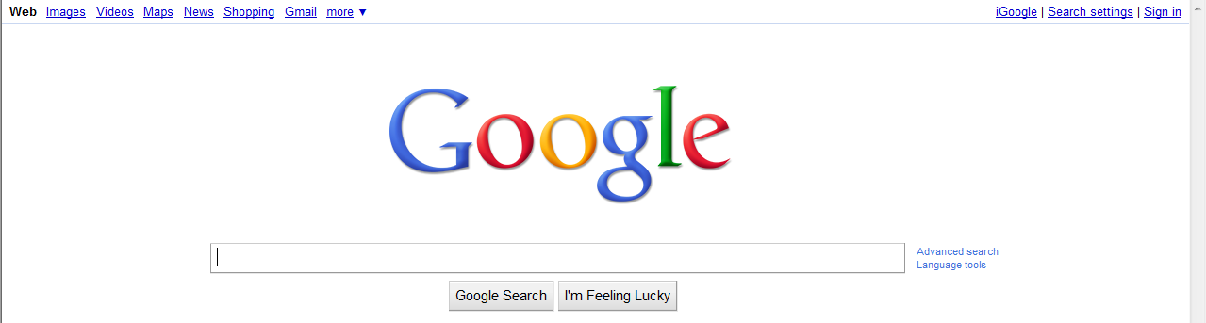
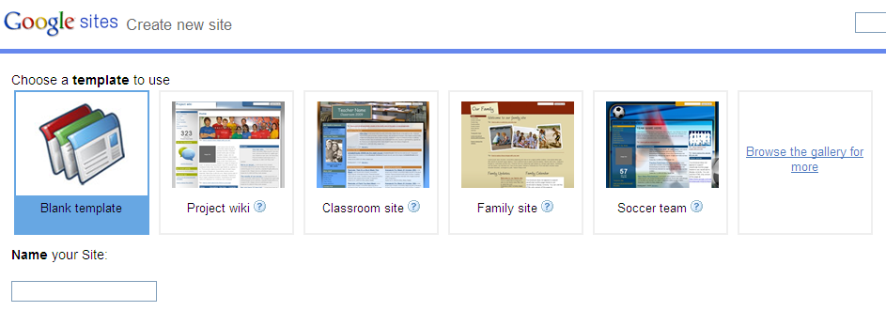
Technology Integration
www.google.com
Google Sites (must be a member – log into your iGoogle account)

Slide 11
Ready, Get Set, Go!
Student Instruction
Copy/Paste into “Sub Notes” for your replacement
Everybody is on the same page.
No misunderstanding
Clear expectation for substitute teacher and student

Slide 12
New and Improved Sub Notes
Use designated page for each class
Create video clips
Use for examples
Use for teacher explanation
Use for sample
Create snapshots
Use when an explanation isn’t necessary
Use as a supplemental visual

Slide 13
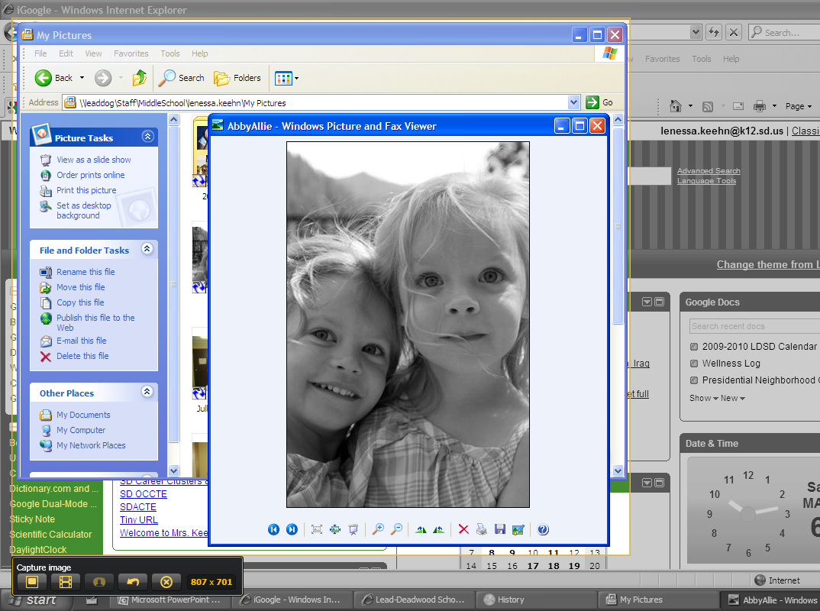
New and Improved Sub Notes
Snapshots
Capture area of computer screen to use
Maximum area to use: size of screen
A
B
C
Snapshot Example
D
Snapshot Example2

Slide 14
New and Improved SubNotes
Video Clips
Capture area of computer screen to use
Maximum recording time = 5 minutes
A
A
B

Slide 15
New and Improved SubNotes
Video Clips
“Share” your clip
Automatic save in online account history
C
D
E
Video Clip Example
G
Video Clip Example3
F
Video Clip Example2
H
Video Clip Example4

Slide 16
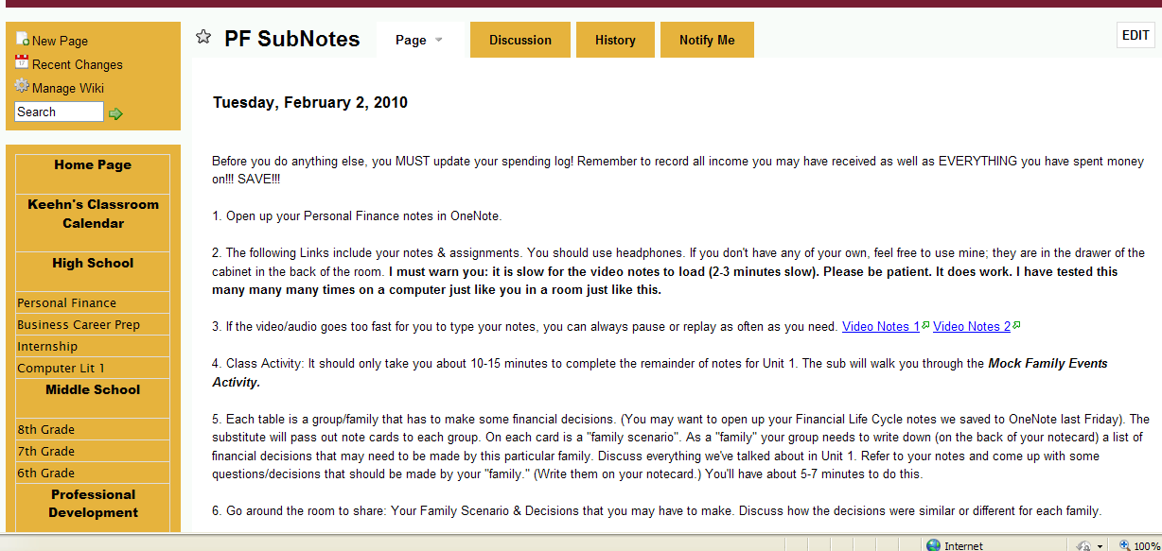
Student Accountability
Student-driven instruction
Each student accountable for own learning
The teacher is gone! (yay!)
Ms. Schamber Mrs. Keehn Mrs. Dirksen**

Slide 17
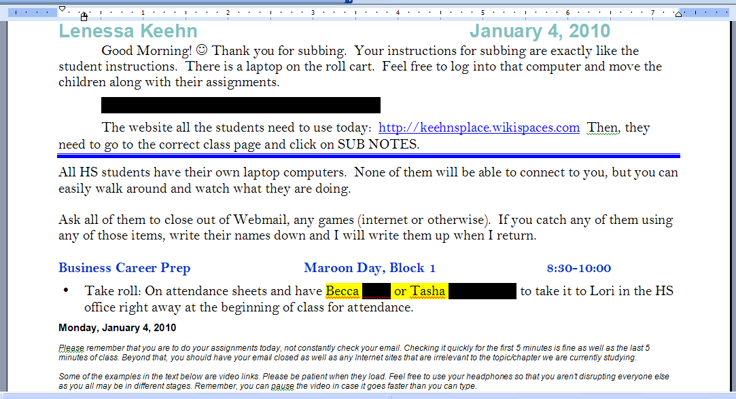
Student Accountability
Substitute Teacher as a facilitator in classroom
Generic Sub Notes in office

Slide 18
Questions? Comments?
For a complete version of this presentation and other resources listed throughout, please go to:
http://fur.ly/4nrk

