Slide 1
Windows 8.1 & My Fujitsu How Do I…?
Lenessa Keehn
Lead-Deadwood School District

Slide 2
The New Windows 8.1
This is biggest change to the User Interface since Windows 95
Uses less System Resources than Windows 7
Is more powerful & efficient
Faster Boot times
Windows Live ID Integration (XX@live.com)
Sky Drive (Cloud service)
Windows App Store - disabled
Seamless search feature

Slide 3
Some features…
Traditional Desktop is changing
Offered it to you – recognizable
Start “Screen” -- not a Start Menu
Windows Apps/Programs 
Live Tile apps become “alive” with content
Charms Bar
Hot Spots – in the corners
Shortcut key combinations

Slide 4
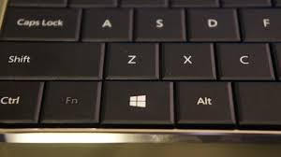
My Fujitsu (NOT Elementary)
Touch Screen
Tablet – everything can be your writing pad! (even email; it is so handy!)
Auto-turn screen
Finger controlled “Pinch zoom”
Beware – the Delete button & the Pause/Break button have been switched on your keyboard!
When in doubt: & are your friends!

Slide 5
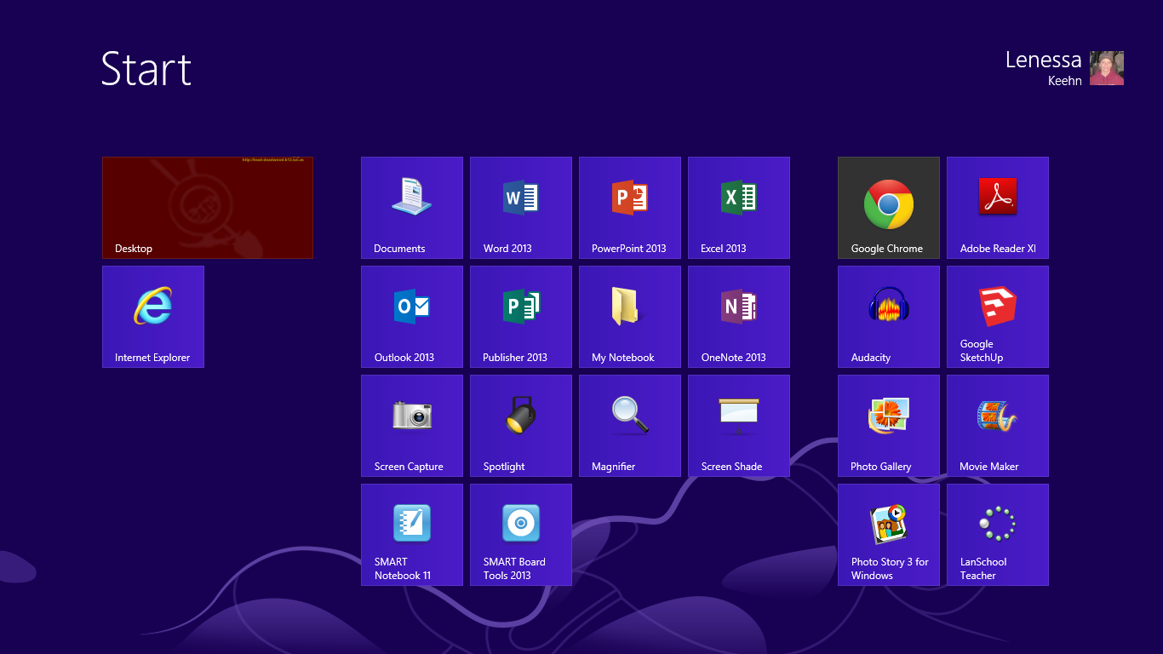
Top 10 Questions: #1
How do I get to the Start Screen? Press Your Windows Button
How do I get to the Desktop?
Click or Touch!

Slide 6
Top 10 Questions: #2
Where is the Search button?
Access your Charms Bar – click the search icon
 + F
On Start Screen in upper right corner:
Simply start typing when on the Start Screen. This automatically starts your search.
This is a new way to search in Windows 8.1
You can search Apps, Settings, Files, and Internet

Slide 7
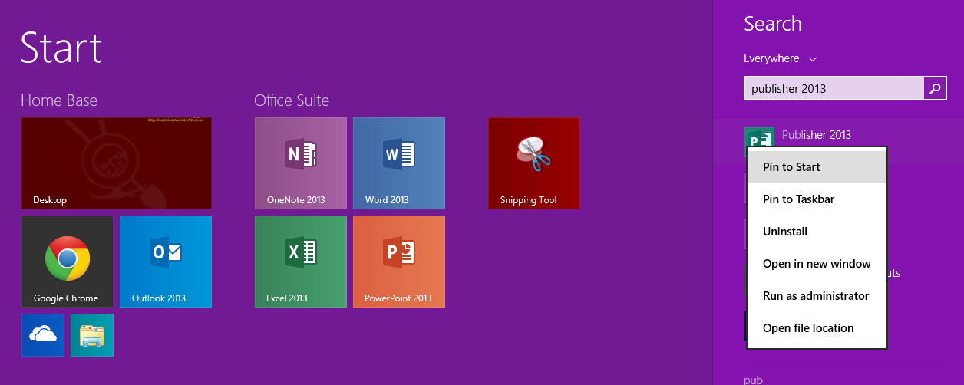
Top 10 Questions: #3
How do I customize my Start Screen?
Search for item
Right Click, Pin to Start (will create a tile)
Click & Drag tiles to rearrange

Slide 8
Top 10 Questions: #4
How do I log out and power down this computer? There is no start button!
Ctrl + Alt + Delete
Use the “Charms Bar”
Shortcut to the Charms Bar
 + C (not on Elementary computer)
Drag with finger from side to center of window
Move mouse to the lower/upper right corner
From here, you can access The Control Panel, LDSD WiFi, Devices (split screen!), Search, & HELP!

Slide 9
Top 10 Questions: #5 (Not Elementary)
If this is a tablet, how do I “use the tablet?”
Grab your pen and activate the “pens” ribbon
Turn your screen around – lay it flat
Use it sideways, upside down, right side up.
No need to convert files for “inking”
Using your Pen
Deactivate the pen “stop inking” to utilize the Right click (button or long-hold)
Opposite button is eraser

Slide 10
Top 10 Questions: #6
Is everything else the same on our computer?
Mostly. We have upgraded our Office Programs to 2013.
The look is slightly different – very grey. Due to efficiency & loading (Microsoft change)
The programs are basically the same.
To the experienced user: You’ll notice small changes in the ribbons and buttons
Inking cannot be used in Publisher. Does work in Word, Excel, PowerPoint, 1Note, & Windows Journal
To the inexperienced user: Yep. It is just the same! ;-)
Open everything just to test it out: What do you use the most? (You’ll also notice these programs are already pinned to your start menu)

Slide 11
Top 10 Questions: #7 #8 #9 #10
These remainder questions are for you to fill in. How do I … ?
What do you need to know how to do to use your Fujitsu or to navigate Windows 8.1?
How do I know that my files are syncing to the server?
Schedule when an event occurs – automatically syncs when you log out. Can’t just power-down
Best Advice: Sign Out EVERYDAY! Shut Down at least 1x a week!

